Slide 1
CSE-4743 Computer Security Part-3
Presented by
Asmaul Hosna Sadika Assistant Lecturer Dept of CSE, IIUC

Slide 2
Contents
Euclid’s Algorithm
Placement of Encryption Function
Link to link encryption
End to end encryption
Traffic Confidentiality
key distribution

Slide 3
Euclid’s algorithm
One of the basic techniques of number theory is the Euclidean algorithm, which is a simple procedure for determining the greatest common divisor of two positive integers.
First, we need a simple definition: Two integers are relatively prime if their only common positive integer factor is 1.
Greatest Common Divisor
Recall that nonzero b is defined to be a divisor of a if a = mb for some m, where a, b, and m are integers. We will use the notation gcd(a, b) to mean the greatest common divisor of a and b. The greatest common divisor of a and b is the largest integer that divides both a and b. We also define gcd(0, 0) = 0
More formally, the positive integer c is said to be the greatest common divisor of a and b if

Slide 4
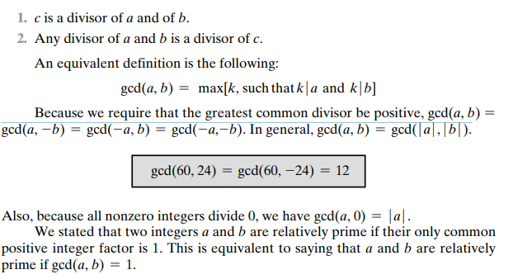
Euclid’s algorithm

Slide 5
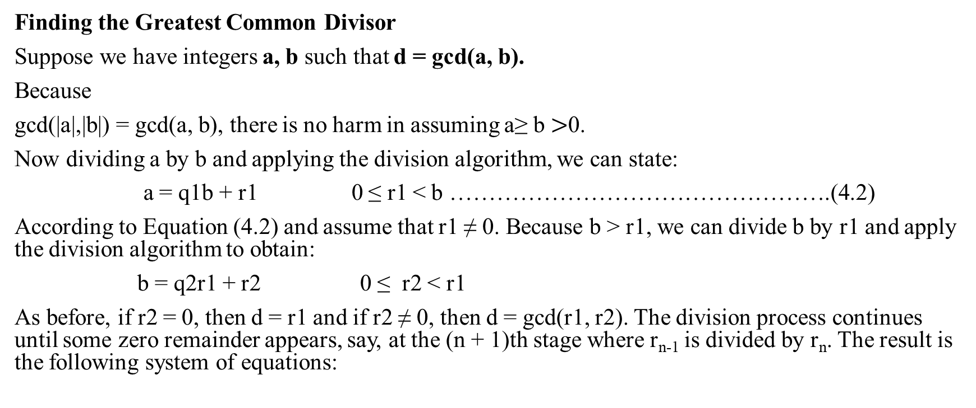
Finding the Greatest Common Divisor
Suppose we have integers a, b such that d = gcd(a, b).
Because
gcd(|a|,|b|) = gcd(a, b), there is no harm in assuming a≥ b $>$0.
Now dividing a by b and applying the division algorithm, we can state:
a = q1b + r1 0 ≤ r1 < b ………………………………………….(4.2)
According to Equation (4.2) and assume that r1 ≠ 0. Because b > r1, we can divide b by r1 and apply the division algorithm to obtain:
b = q2r1 + r2 0 ≤ r2 < r1
As before, if r2 = 0, then d = r1 and if r2 ≠ 0, then d = gcd(r1, r2). The division process continues until some zero remainder appears, say, at the (n + 1)th stage where r_{n-1} is divided by r_{n}. The result is the following system of equations:

Slide 6
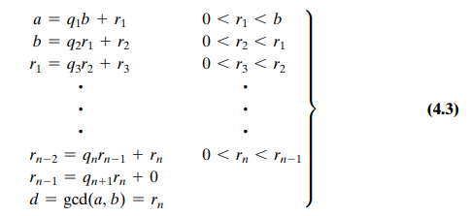
Euclid’s algorithm
At each iteration, we have
d = gcd (ri, ri+1) until finally d = gcd (rn, 0) = rn.
Thus, we can find the greatest common divisor of two integers by repetitive application of the division algorithm. This scheme is known as the Euclidean algorithm

Slide 7
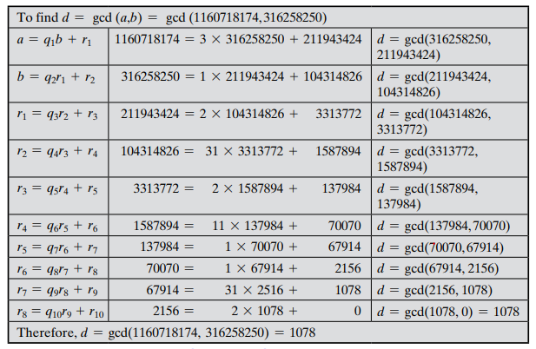
An example

Slide 8
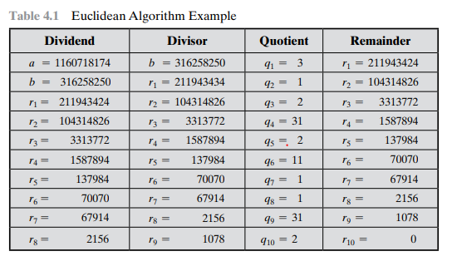

Slide 9
Placement of Encryption Function
If encryption is to be used to counter attacks on confidentiality, we need to decide what to encrypt and where the encryption function should be located.
To begin, this section examines the potential locations of security attacks and then looks at the two major approaches to encryption placement: link and end-to-end.
There are a large number of locations at which an attack can occur. Furthermore, for wide area communications, many of these locations are not under the physical control of the end user. Even in the case of local area networks, in which physical security measures are possible, there is always the threat of disgruntled employee.

Slide 10
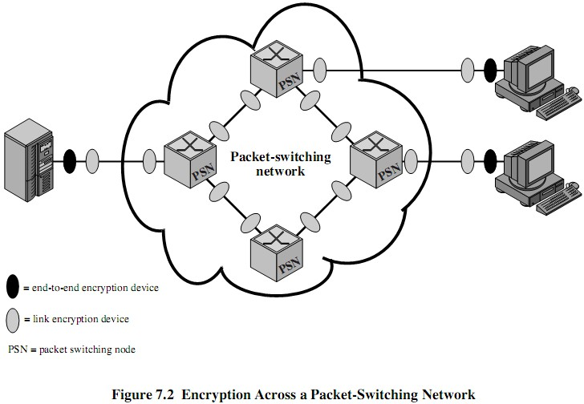
Placement of Encryption Function

Slide 11
Placement of Encryption Function
Link to Link Encryption
With link encryption, each vulnerable communications link is equipped on both ends with an encryption device.
Thus, all traffic and overall communications links are secured.
One of its disadvantages is that the message must be decrypted each time it enters a switch because the switch must read the address (logical connection number) in the packet header in order to route the frame. Thus, the message is vulnerable at each switch.
If working with a public network, the user has no control over the security of the nodes.
For this strategy to be effective, all the potential links in a path from source to destination must use link encryption. Each pair of nodes that share a link should share a unique key, with a different key used on each link. Thus, many keys must be provided.

Slide 12
Placement of Encryption Function
End to End encryption
With end-to-end encryption, the encryption process is carried out at the two end systems.
The source host or terminal encrypts the data. The data in encrypted form are then transmitted unaltered across the network to the destination terminal or host. The destination shares a key with the source and so is able to decrypt the data.
This plan seems to secure the transmission against attacks on the network links or switches.
Thus, end-to-end encryption relieves the end user of concerns about the degree of security of networks and links that support the communication. There is, however, still a weak spot.

Slide 13
End-to-end vs link-to-link
Thus, with end-to-end encryption, the user data are secure. However, the traffic pattern is not, because packet headers are transmitted in the clear.
On the other hand, end-to-end encryption does provide a degree of authentication. If two end systems share an encryption key, then a recipient is assured that any message that it receives comes from the alleged sender, because only that sender shares the relevant key. Such authentication is not inherent in a link encryption scheme.
How to achieve greater security
To achieve greater security, both link and end-to-end encryption are needed, as is shown in Figure 7.2. When both forms of encryption are employed, the host encrypts the user data portion of a packet using an end-to-end encryption key. The entire packet is then encrypted using a link encryption key. As the packet traverses the network, each switch decrypts the packet, using a link encryption key to read the header, and then encrypts the entire packet again for sending it out on the next link. Now the entire packet is secure except for the time that the packet is actually in the memory of a packet switch, at which time the packet header is in the clear.

Slide 14
End-to-end vs link-to-link

Slide 15
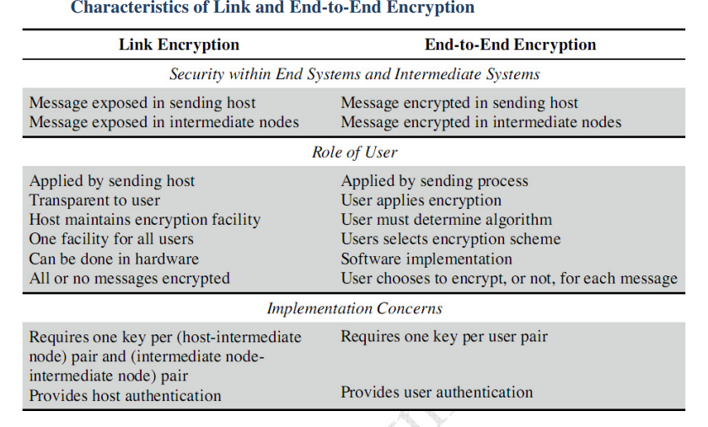

Slide 16
Key distribution
For symmetric encryption to work, the two parties to an exchange must share the same key, and that key must be protected from access by others.
Furthermore, frequent key changes are usually desirable to limit the amount of data compromised if an attacker learns the key.
Therefore, the term that refers to the means of delivering a key to two parties who wish to exchange data, without allowing others to see the key.
For two parties A and B, key distribution can be achieved in a number of ways, as follows:
A can select a key and physically deliver it to B.
A third party can select the key and physically deliver it to A and B.
If A and B have previously and recently used a key, one party can transmit the new key to the other, encrypted using the old key.
If A and B each has an encrypted connection to a third party C, C can deliver a key on the encrypted links to A and B.

Slide 17
Key distribution
Physical delivery (1 & 2) is simplest - but only applicable when there is personal contact between recipient and key issuer. This is fine for link encryption where devices & keys occur in pairs, but does not scale as number of parties who wish to communicate grows. 3 is mostly based on 1 or 2 occurring first.
A third party, whom all parties trust, can be used as a trusted intermediary to mediate the establishment of secure communications between them (4). Must trust intermediary not to abuse the knowledge of all session keys. As number of parties grow, some variant of 4 is only practical solution to the huge growth in number of keys potentially needed.

Slide 18
Key distribution
Key distribution centre:
The use of a key distribution center is based on the use of a hierarchy of keys. At a minimum, two levels of keys are used.
Communication between end systems is encrypted using a temporary key, often referred to as a session key.
Typically, the session key is used for the duration of a logical connection and then discarded
master key is shared by the key distribution center and an end system or user and used to encrypt the session key.

Slide 19
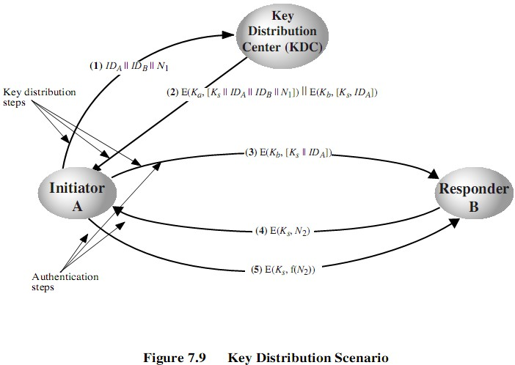
Key Distribution
Let us assume that user A wishes to establish a logical connection with B and requires a one-time session key to protect the data transmitted over the connection. A has a master key, K_{a}, known only to itself and the KDC; similarly, B shares the master key K_{b} with the KDC.

